Slide 1


VIVEKANANDA INSTITUE OF TECHNOLOGY (Affiliated to VTU and approved by AICTE) Gudimavu, Kumbalagodu post, Kengeri, off Mysore road Bengaluru-560074
DEPARTMENT OF CIVIL ENGINEERING
TECHNICAL SEMINAR
On
“ARTSCIENCE MUSEUM”
Presented By:
NANDISH U ( 1VK19CV403 )
VIII Sem
Department of Civil Engineering, VKIT
Guided By:
Dr. SHASHI KUMAR C S
Associate Professor & Head
Dept. of Civil Engineering
VKIT, Bengaluru

Slide 2
CONTENTS
INTRODUCTION
LOCATION
PLAN
ARCHITECTURE
GALLERY SPACES
SUSTAINABILITY FEATURES
DESIGN
GEOMETRY OF FLOWER
METHODOLOGY
MODELLING & COORDINATION
STRUCTURAL SCHEME
FEATURE EXHIBITION
REFERENCES

Slide 3
INTRODUCTION
ArtScience Museum is a museum within the integrated resort of Marina Bay Sands in the Downtown core of the Central area in Singapore. Opened on 17 February 2011 by Singapore's Prime Minister Lee Hsien Loong, it is the world's first ArtScience museum, featuring major exhibitions that blend art, science, culture and technology.
The ArtScience Museum is a key permanent attraction of the Marina Bay Sands Integrated Resort located at Bayfront Avenue. The largest private museum in Singapore, it focuses on the connections between art and science through hi-tech exhibits that push disciplinary boundaries.
Designed by world-renown architect Moshe Safdie, the museum is in the shape of a lotus with 10 irregular petals.
This unique structure features over 5500m²of galleries housing the permanent and touring exhibitions, and embraces a spectrum of influences from the relationship between art and science, to media and technology, to design and architecture.

Slide 4
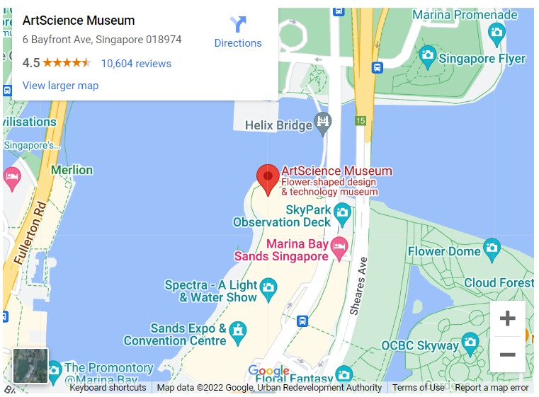
LOCATION

Slide 5
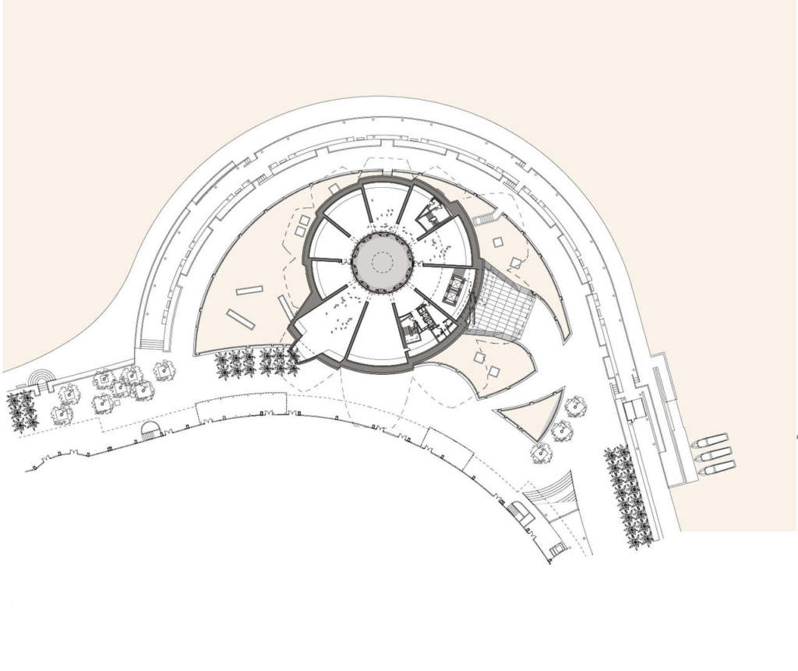
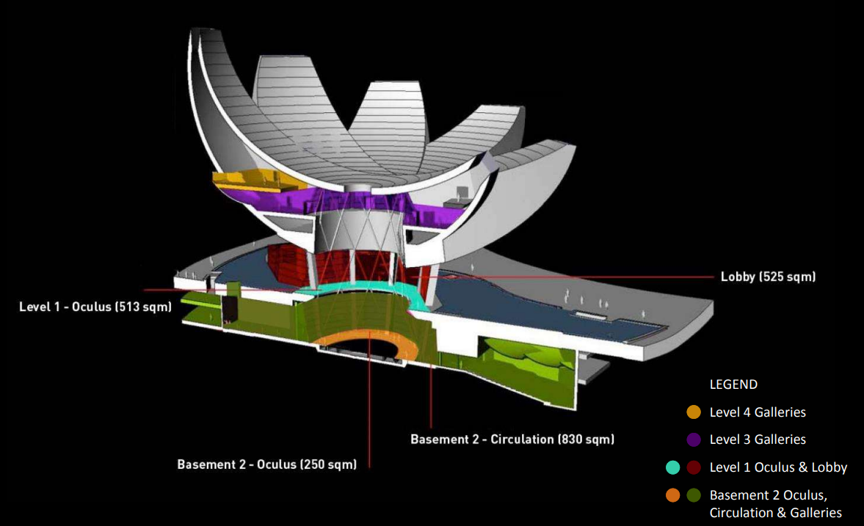
PLAN

Slide 6
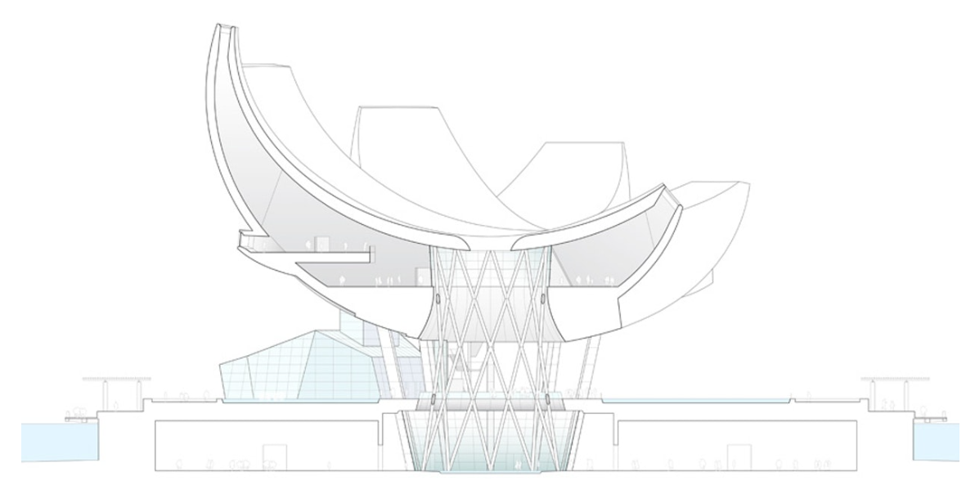
SECTION

Slide 7
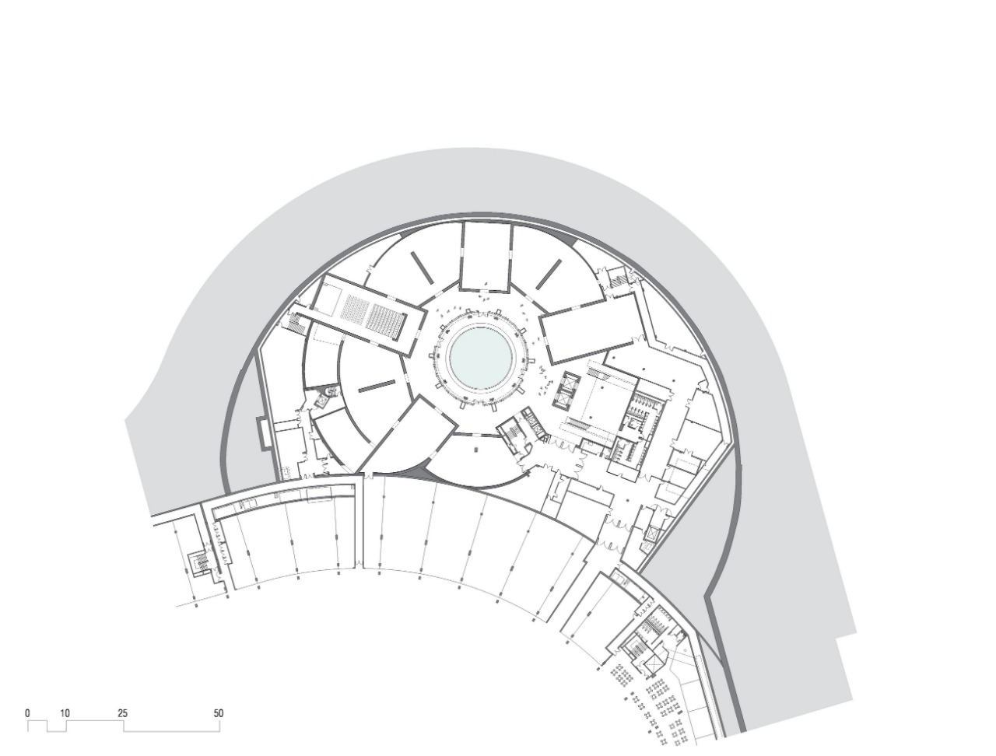
BASEMENT 1

Slide 8
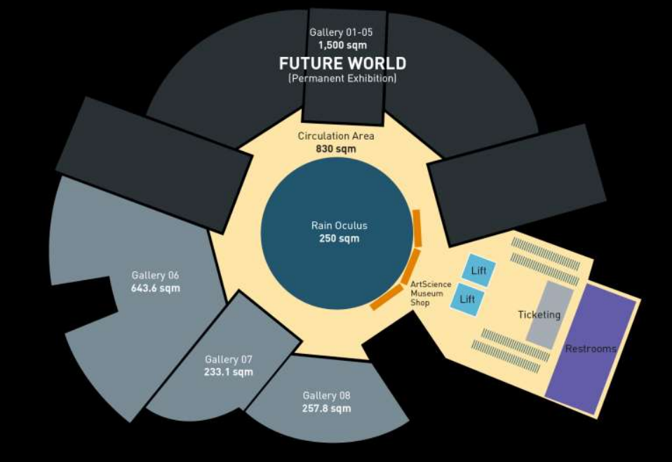
BASEMENT 2&3

Slide 9
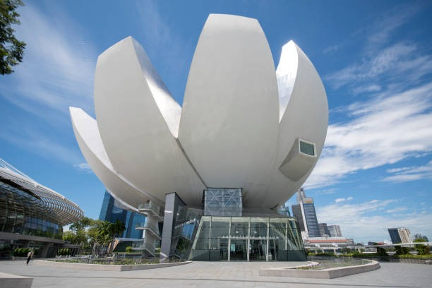
ARCHITECTURE
GALLERY SPACE
The ArtScience Museum has 21 gallery spaces with a total area of 64,583 square feet (6,000 square meters)

Slide 10
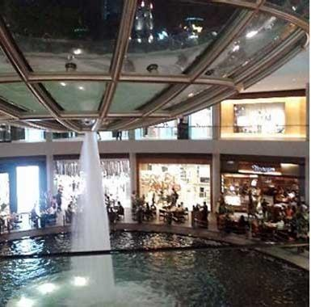
SUSTAINABILITY FEATURES
Rainwater is harvested and channeled down the center of the building, flowing through its bowl-shaped roof into a reflecting pond at the lowest level of the building.
The rainwater is then recycled for use in the building's restrooms.

Slide 11
DESIGN
The design of the museum is conceptualized in two parts:
The flowerlike superstructure made of ten petals seemingly a float in a giant lily pond, and the base, embedded beneath the same waterbody.
The museum is composed of twenty-one galleries spread over 3 stories, across 6,000 square meters of floor space.
The ten upper galleries vary in shape and height, making the discovery of each new space an exciting experience.
Double-height vertical spaces transition seamlessly into long horizontal rooms, each cleverly illuminated by sunlight filtering in through the skylights above as well as the central atrium.
The galleries also have picture windows that frame expansive views of the breath taking waterfront.

Slide 12
GEOMETRY OF A FLOWER
The precise curves of the petals were generated by intersecting spheroids of varying radii. They rise from the pond in varying heights, with the tallest reaching 60 m into the sky above.
Each doubly curved surface is sheathed in a fiber-reinforced polymer skin to achieve a seamless finish.
This is a material typically used in the construction of boats and yachts. The joint less gleaming white surfaces lend lightness to the structure that reinforces the concept of a floating lotus.
The vertical side panels of the petals are cladded in bead-blasted stainless steel panels.
The gently curving concave roof collects rainwater which drains through an oculus, forming a central waterfall. The water then feeds an indoor pond at the base of the atrium.

Slide 13
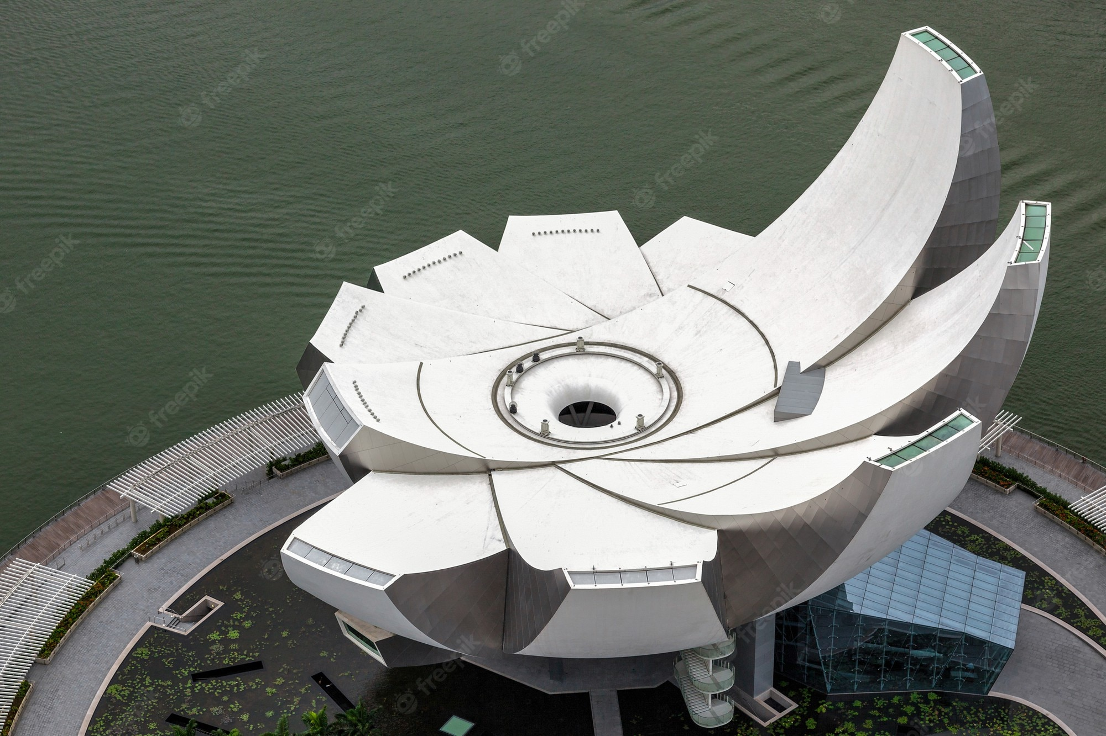

Slide 14
METHODOLOGY
The museum is organized as two major exhibition spaces, positioned around a central open-space atrium. The first exhibits hover within a sculpturally shaped form over the promenade, and a second collection of gallery spaces are located beneath a large water lily garden.
The building is supported by a steel lattice diagrid structure and ten steel columns –a sculptural centerpiece that allows the building to seemingly float above. The geometry of the shape is often compared to a lotus, and is clad with fiber-reinforced polymer (FRP), typically used in high-performance racing yachts.
The upper galleries are organized into 10 halls that vary from double height vertical spaces, to long horizontal rooms. Each hall has access to daylight from skylights above and from the central atrium. Integrated lighting control mechanisms allow the spaces to be transformed to black boxes. Large picture windows from within the galleries offer views to the promenade below.

Slide 15
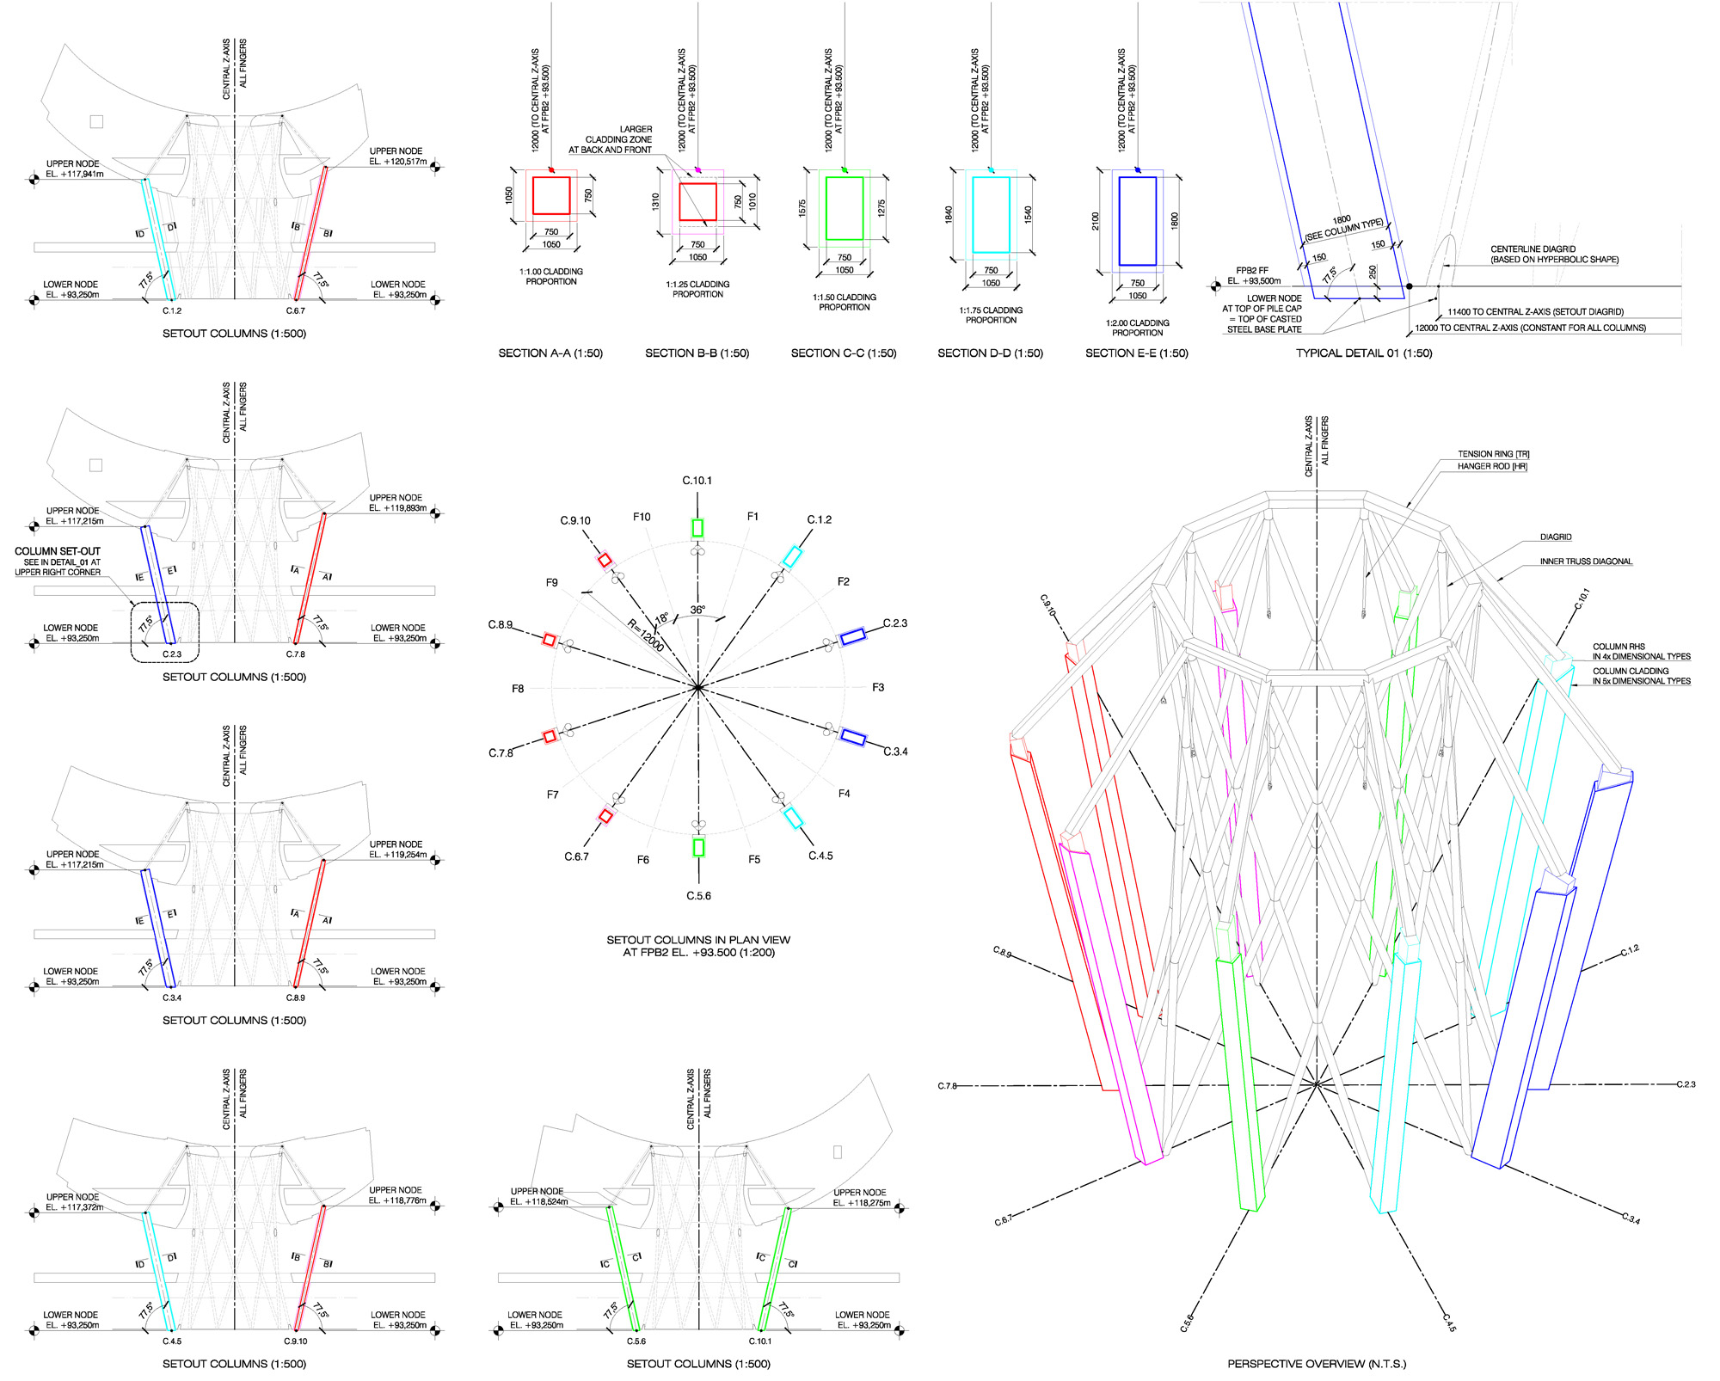

Slide 16
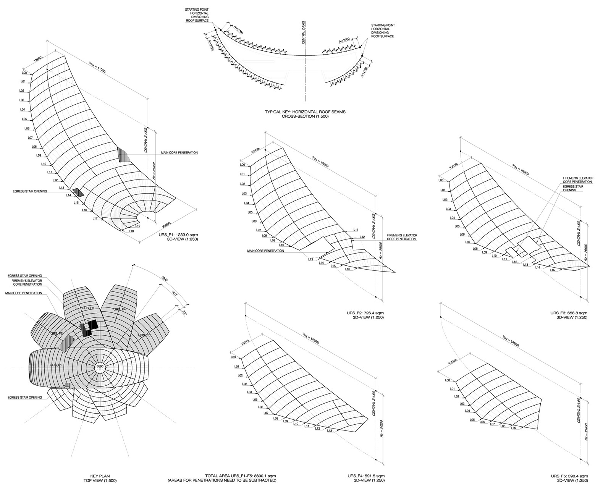

Slide 17
MODELLING & COORDINATION
The highly complex geometry of the lotus shape led the design team to use parametric modelling techniques for the structural steel skeleton.
MSA developed a Rhino model to generate the surface profiles, and then used these surfaces to develop a parametric model of the steel work centerlines using Bentley’s Generative Components software.
The centerline model was then exported to generate a space frame analysis model of the roof in GSA program, and following analysis and section size definition, the GSA analysis model was imported.
On completion of the 3-D drafting, the model was exported and issued to the steel work contractor as the basis for their fabricate on model. The Micro Station model was also used to generate a record set of 2-Ddrawings for the project.

Slide 18
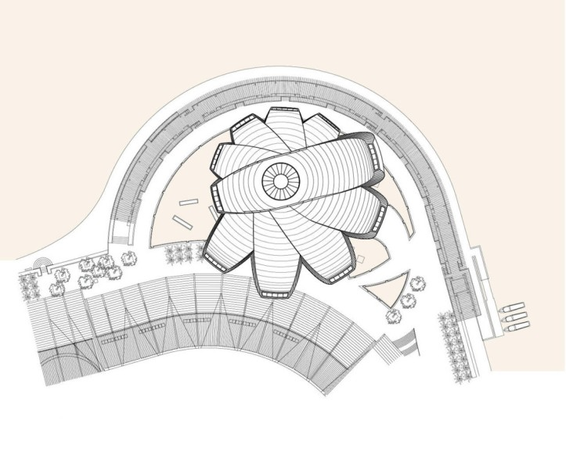
MODELLING

Slide 19
STRUCTURAL SCHEME
Each petal is formed by secondary members spanning onto primary girders, which load side trusses that bend downwards in cantilever action. The side trusses of adjacent petals meet at waler beams which resist out-of-plane forces caused by the steps in the roof between each petal. Loads from the side trusses are resolved at the waler beams and transferred to the radial mega-trusses.
These act as cantilevers, taking the museum loads to the vertical supports which consist of a central diagrid structure and a series of10 mega-columns, inclined outwards.
Tensile loads in the top chords are resolved into the tension ring which connects to the top of the diagrid, while the compressive loads are resolved into the compression ring below. The vertical loads are carried by the inclined mega-columns.

Slide 20
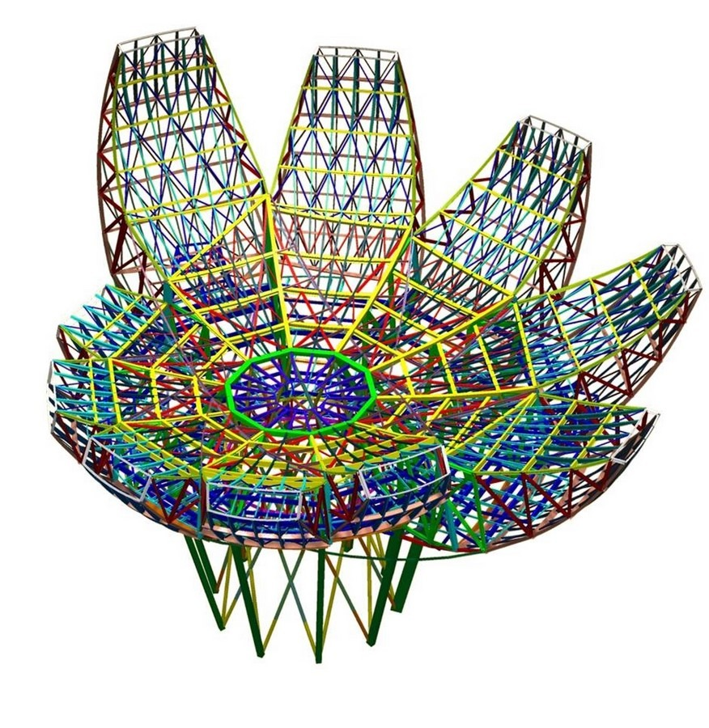
STEEL TRUSS

Slide 21
STRUCTURAL DATA
Cantilevered gallery trusses with 24-inch by 24-inch box section chords were employed to carry the galleries. However, these posed a significant challenge as their large reactions demanded resolution where they met the atrium, precisely where the architectural form was intended to run unencumbered.
In response, Arup devised a system of tension and compression rings encircling a central hyperbolic diagrid of straight 20-inch diameter circular hollow steel sections.
The gallery trusses are configured to deliver the large horizontal forces from their top chords into the 30-inch by 30-inch steel tension ring, built up from 2-inch thick steel plates along the top of the diagrid.
Any net horizontal forces on the tension ring, whether caused by wind, earthquake, or unbalanced gravity loads, are carried to the ground through the diagrid via shear and overturning action.
to the ground through the diagrid via shear and overturning action. Forces from the diagonals and the bottom chords are carried by a spiraling 35-inch square compression ring built from 2-inch plates and by an inclined colonnade of 71-inch by 30-inch built-up steel box mega-columns welded from 19/16-inch steel plate.
The compression ring encircles but does not touch the diagrid, thereby protecting the diagrid from the large horizontal thrusts generated along bottom chords of the gallery trusses

Slide 22
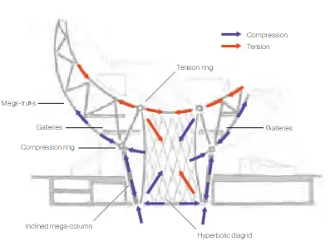
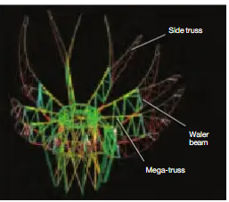

Slide 23
FEATURE EXHIBITION
The ArtScience Museum features gallery spaces totaling 50,000 square feet (6,000 square meters) for exhibits from combined art/science, media/technology, as well as design/architecture motifs.
Permanent exhibits include objects indicative of the accomplishments of both the arts and the sciences through the ages, along the lines of Leonardo da Vinci's Flying Machine, a Kongming Lantern, and a high-tech robotic fish.
The museum opened with an exhibition of a collection of the Belitung shipwreck cargo, and Tang dynasty treasures that were discovered and preserved by Tillman Walter fang of Seabed Explorations NZ Ltd.

Slide 24
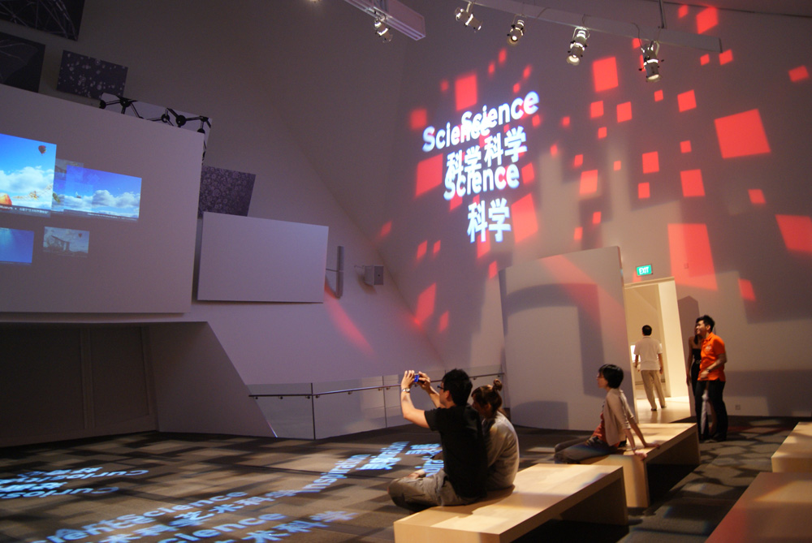
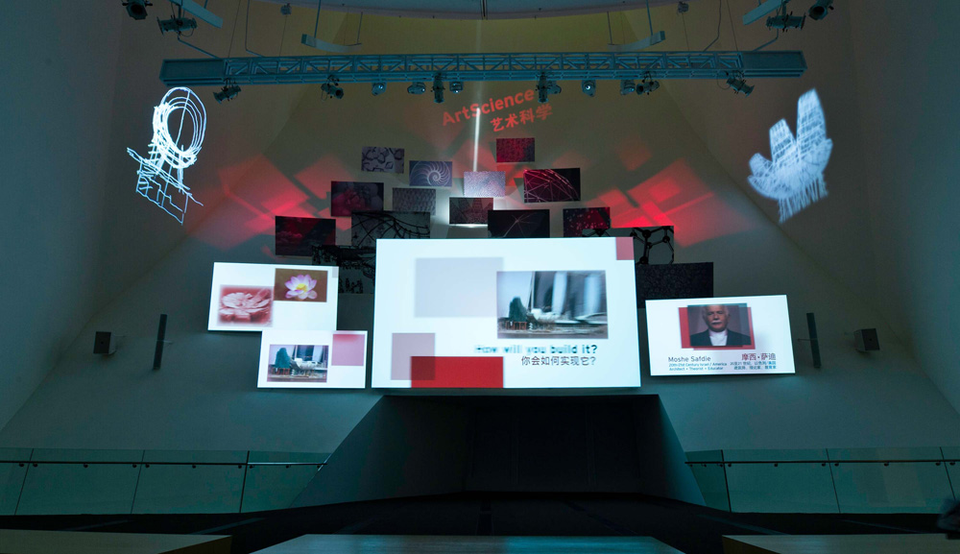

Slide 25
QUESTIONS
What is art science definition?
ArtScience involves understanding the human experience of nature through the synthesis of artistic and scientific modes of exploration and expression. ArtScience melds subjective, sensory, emotional and personal understanding with objective, analytical, rational, public understanding.
What is the Artscience museum made of?
The building is supported by a steel lattice diagrid structure and ten steel columns –a sculptural centerpiece that allows the building to seemingly float above. The geometry of the shape is often compared to a lotus, and is clad with fiber-reinforced polymer (FRP), typically used in high-performance racing yachts.
What is the shape of ArtScience Museum?
Lotus
Designed by world-renown architect Moshe Safdie, the museum is in the shape of a lotus with 10 irregular petals. It opened its doors to the public on 19 February 2011,³ and can accommodate about 3,500 visitors at any one time.

Slide 26
REFERENCES
"About ArtScience Museum". Marina Bay Sands. Archived from the original on 3 July 2013. Retrieved 10 July 2013.
"Design: Architecture in Bloom - Singapore's ArtScience Museum". Time. 177 (14): 52–53. 11 April 2011.
Jump up to:“ Travel the ancient Silk Road for the first time Asia". www.marinabaysands.com. Archived from the original on 11 February 2011. Retrieved 28 March 2011.
"Ninth century Tang archaeological finds go on display at Integrated Resort Marina Bay Sands' latest architectural showpiece". Archived from the original on 2011-10-02. Retrieved 2011-03-28.
"Van Gogh's masterpieces come alive at Marina Bay Sands' ArtScience Museum". Archived from the original on 12 April 2011. Retrieved 24 April 2011.
"Explore the distorted reality of Dalí: Mind of a Genius – The Exhibition at ArtScience Museum at Marina Bay Sands". Archived from the original on 26 April 2011. Retrieved 24 April 2011.

Slide 27
ArtScience Museum at Marina Bay Sands hosts the first Cartier Time Art exhibition in Asia" (PDF). Archived from the original (PDF) on 2012-05-17. Retrieved 2011-10-20.
"Largest collection of Warhol's artworks ever displayed in Singapore at ArtScience Museum" (PDF). Archived from the original (PDF) on 2012-03-23. Retrieved 2012-02-09.
"Experience the Magic of HARRY POTTER: THE EXHIBITION for the First Time in Asia at ArtScience Museum, Singapore" (PDF) (Press release). Marina Bay Sands. Archived from the original (PDF) on 2012-05-17.
"ArtScience Museum zooms in on Outside In: A Magnum Photos Showcase" (PDF). Archived from the original (PDF) on 2012-10-05. Retrieved 2012-11-09.
"The Art of the Brick brings sculptures to life at ArtScience Museum" (PDF).
"Fujians: The Blue Ocean Legacy exhibition at Marina Bay Sands opens in conjunction with the 7th World Fujian Convention" (PDF). Archived from the original (PDF) on 2013-01-21. Retrieved 2012-12-26.

Slide 28
THANK YOU

